Slide 1

Detection of Cardiovascular disease using different machine learning algorithms followed by PCA(Principal Component Analysis) and LDA(Linear Discriminant Analysis)
Group - 01
Name | I.D
Farhan Sharukh Hasan | 170204066
Rahat Kader Khan | 170204074
Shweta Bhattacharjee Porna | 170204111

Slide 2
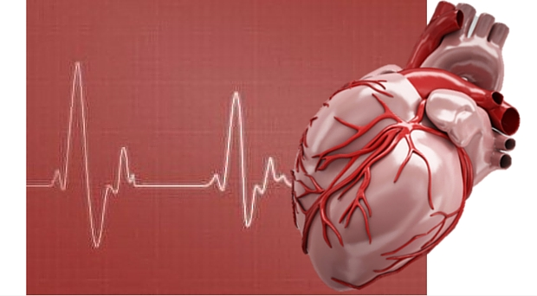
Introduction
Most diseases are related to the heart so the prediction about heart diseases is necessary. Machine Learning plays a decisive role in predicting outcomes of these diseases. Any technology that can help detect these diseases before much damage is done will shows that it is helpful in saving people's money and further significantly their life.

Slide 3
Literature Review
Previous Work | Author | Methodology
Prediction of cardiovascular disease by applying a combination of principal component analysis with machine learning techniques (2021) | Advait Shirvaikar, Advait Mandlik | Logistic Regression, Support Vector Machine, K nearest neighbour, Random Forest Naive Bayes in combination with Principal Component Analysis (PCA)
Heart disease prediction using machine learning (2021) | A. K. Anupama Yadav, Levish Gediya | KNN random forest Decision tree SVM Gaussian SVM
Cardiovascular disease prediction using machine learning (2020) | D. Kumar, Bavithra | Logistic Regression, Support Vector Machines (SVM), K-Nearest Neighbors (KNN), Naive Bayes, Random Forest Supervised Learning algorithms.

Slide 4
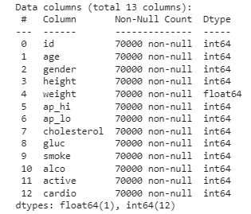
Data Collection
We collected the dataset from Kaggle. The dataset contains 70,000 rows(samples) and 13 columns(including the features and label) in total. The feature names and label are shown here:

Slide 5
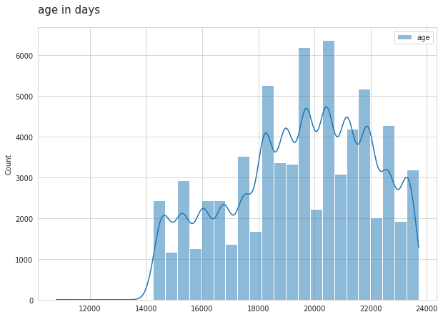
Dataset Visualization
Age in days

Slide 6
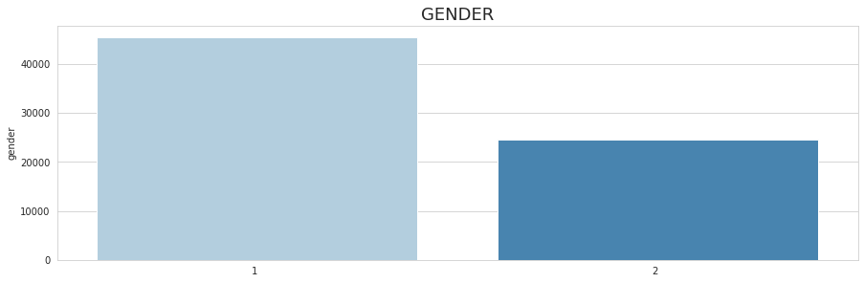
Gender

Slide 7
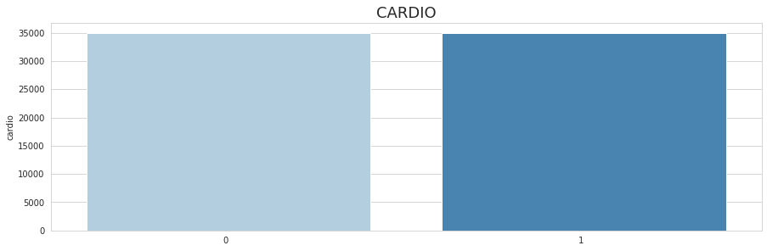
Cardiovascular or not

Slide 8
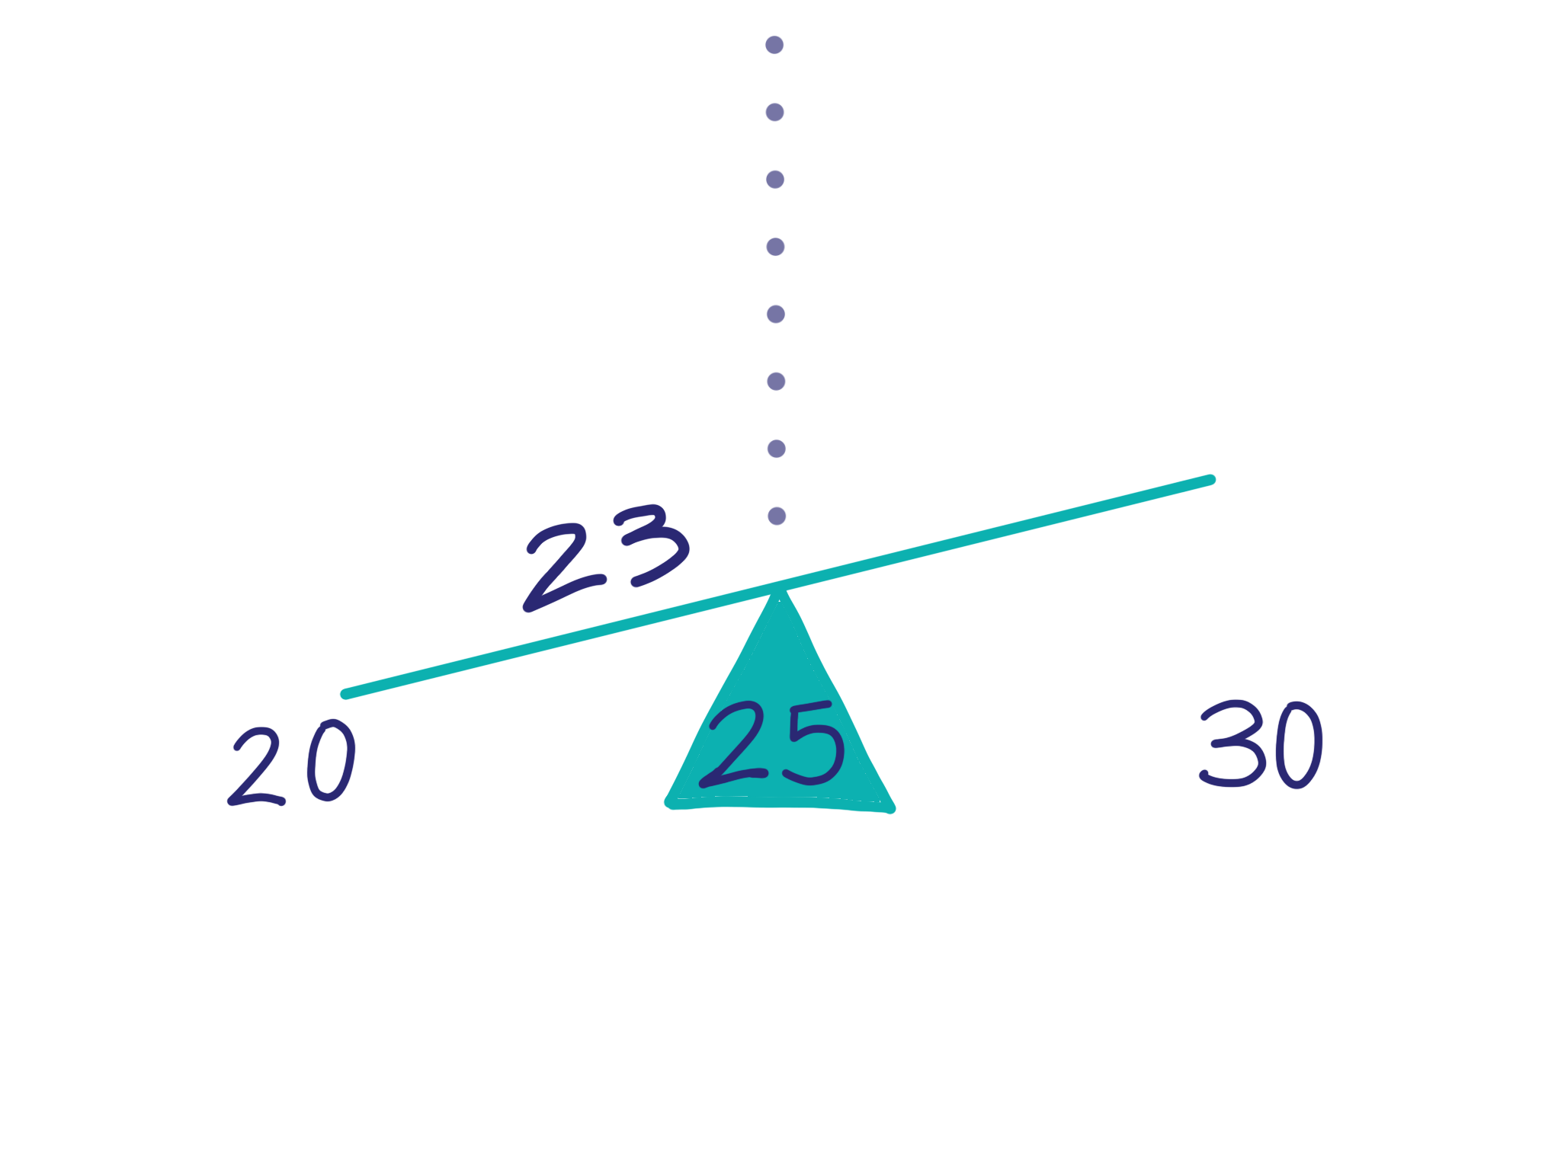
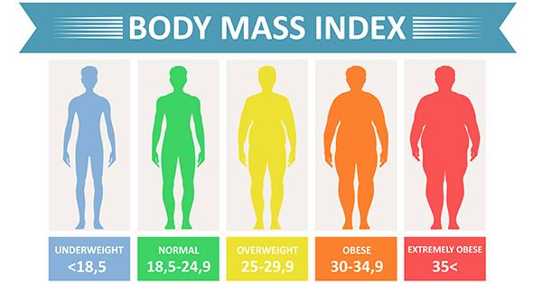
Feature Engineering
Rounding of the age in the dataset
Calculation of body mass index

Slide 9
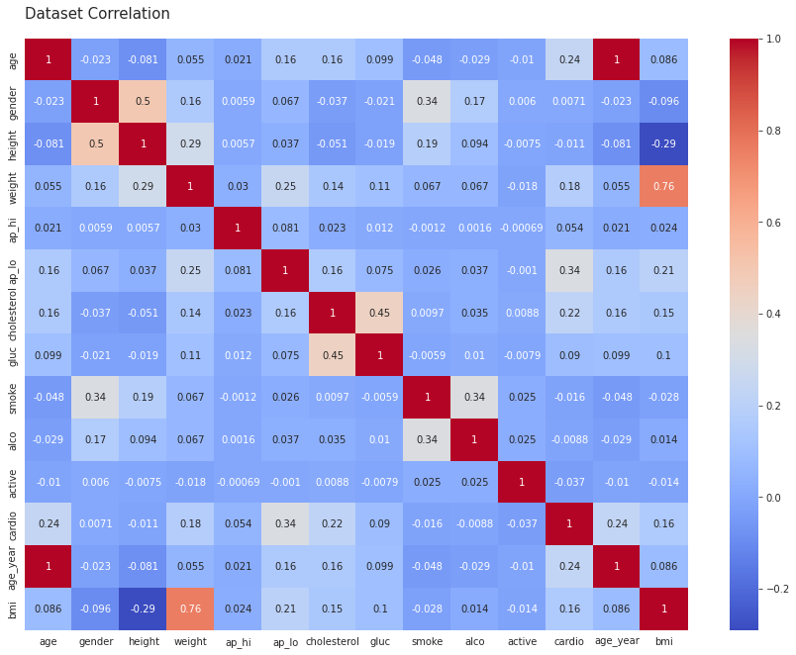
Feature Selection
Data Correlation

Slide 10
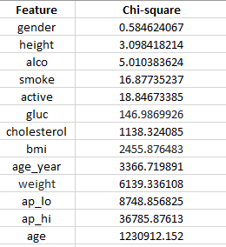
Chi-Squared statistical

Slide 11
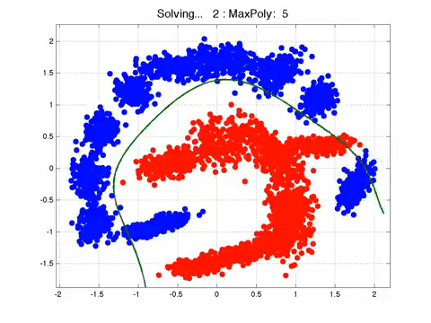
Methodology
Model
Logistic Regression

Slide 12
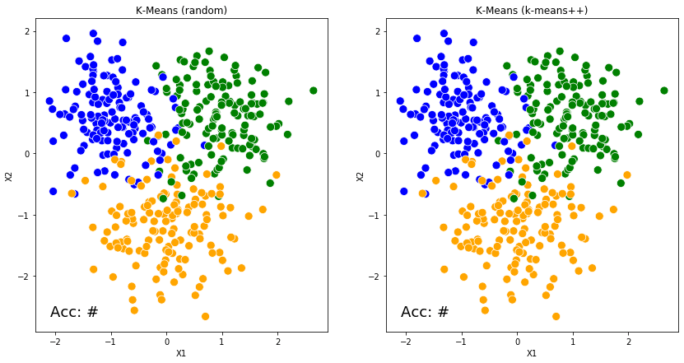
Model
K-Nearest Neighbour

Slide 13
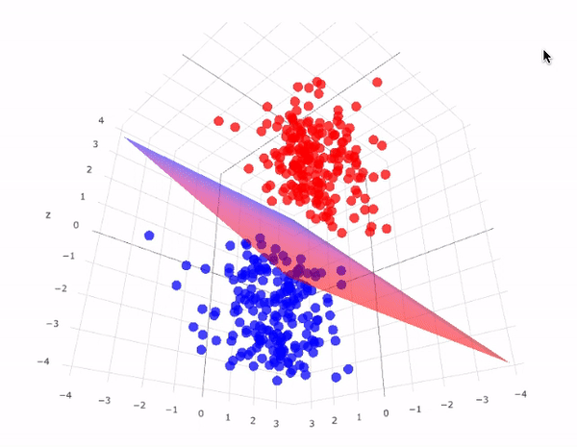
Model
Support Vector Machine

Slide 14
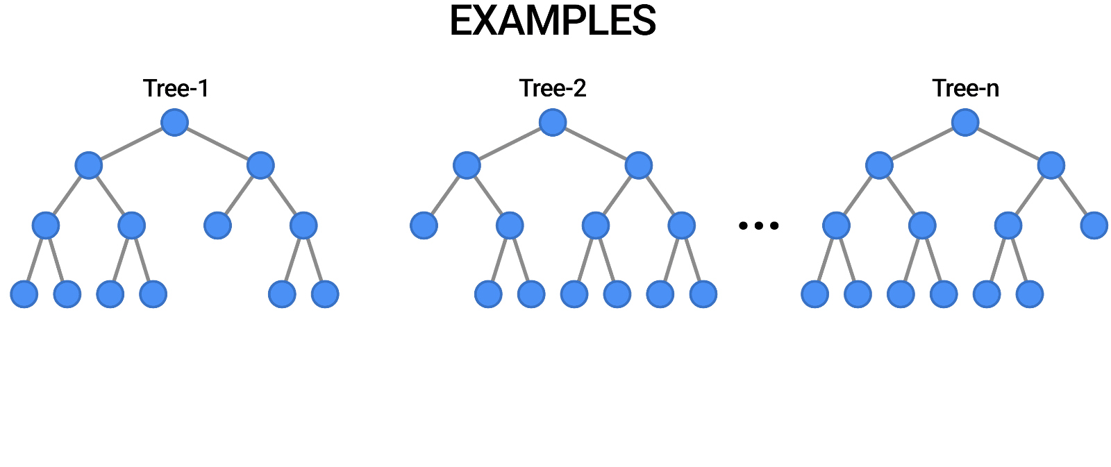
Model
Random Forest Classifier

Slide 15
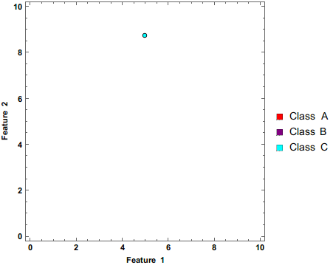
Model
Naive Bayes

Slide 16
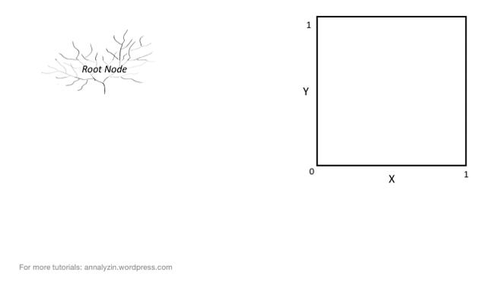
Model
Decision Tree

Slide 17
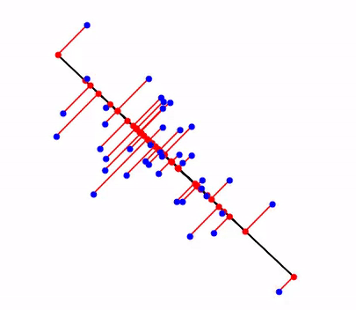
Dimension Reduction
Principal Component Analysis

Slide 18
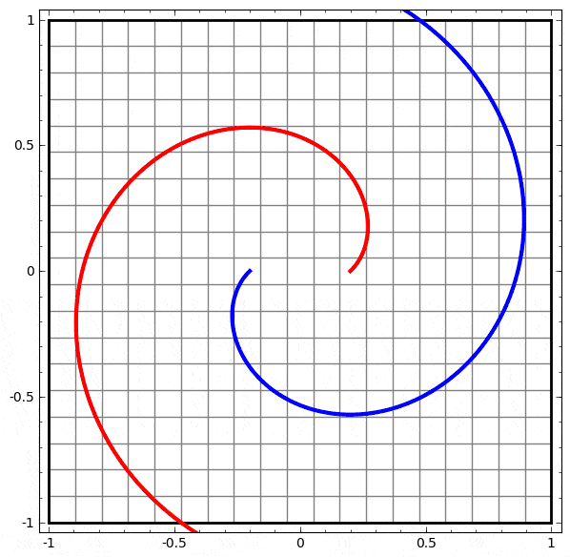
Dimension Reduction
Linear Discriminant Analysis

Slide 19
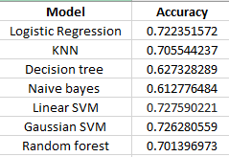
Experiment and Result
One Hot Encoding

Slide 20
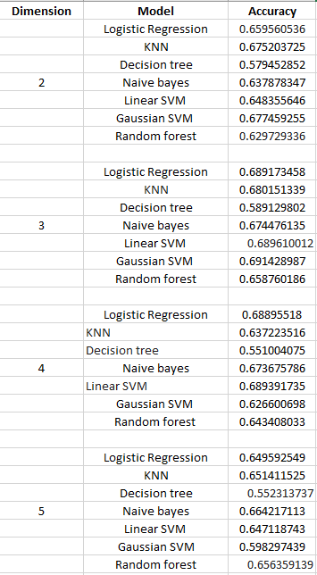
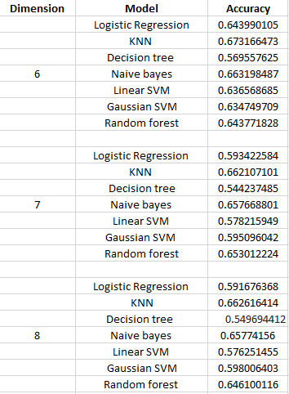
Principal Component Analysis

Slide 21
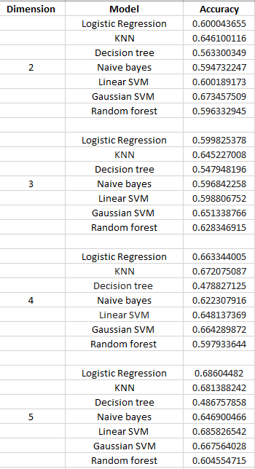
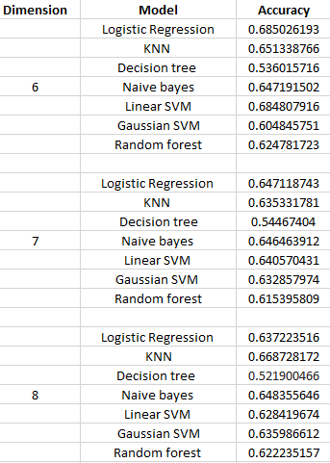
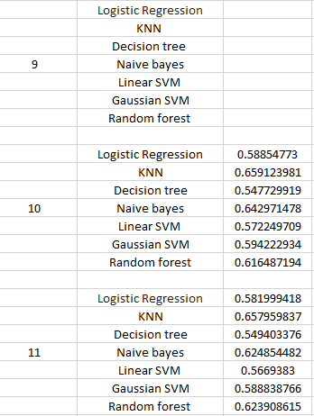
One Hot Encoding with Principal Component Analysis

Slide 22
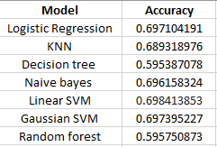
Linear Discriminant Analysis

Slide 23
One Hot Encoding with Linear Discriminant Analysis

Slide 24
Future Work and Conclusion
The motivation for the study was to find the most accurate Machine Learning classification
algorithm for prediction of cardiovascular disease. This study compares the accuracy and
recall score of 9 algorithms namely Logistic regression, K-Nearest Neighbour, Support Vector
Machine, Random Forests and Naive Bayes. Data is collected from the dataset published by
Svetlana Ulianova as in the title of Cardiovascular Disease dataset.

